Slide 1
Synthetic Datasets and Explainability
Jesse He

Slide 2
Machine Learning Explanations and Synthetic Datasets
Greater adoption of machine learning in diverse fields requires interpretable explanation in order to trust models
We can use existing datasets to test models and explanation frameworks, but these may be difficult to find or gather
Generating new datasets that are easy to visualize lets us investigate these models and explanations more easily
A tool for generating such datasets lets us customize these example problems

Slide 3
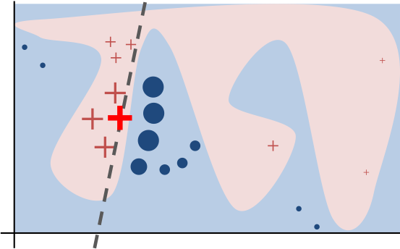
What Is LIME?
LIME stands for
Local
Interpretable
Model-agnostic
Explanation
LIME tries to explain why a classifier makes a prediction by observing the classifier’s behavior on nearby points. [1]
LIME has been successful with image and text data but has trouble with tabular data. [2]
Intuition for LIME [1]

Slide 4
Why Polygons?
Generate synthetic classification problems with tabular data to see what LIME is doing
Use geometry to describe n-dimensional data clusters
Geometrically defined boundaries let us easily customize the difficulty of the classification problem
Polygonal models can be helpful representations of clusters in machine learning [3] but polygonal datasets lack a robust synthetic generation tool

Slide 5
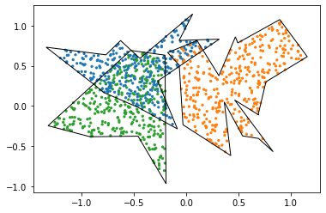
Generating Polygonal Clusters
Start by generating a random polygon
Generate a few points in polar and connect them counterclockwise
The distance from each point to a “center” point is in some range
Use rejection sampling to generate points inside the polygon
Use this to generate multiple polygons around different centers

Slide 6
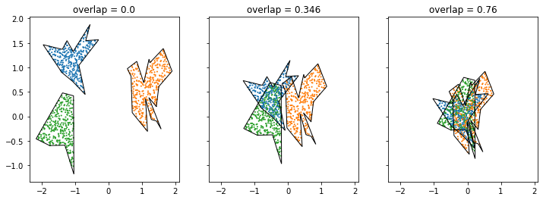
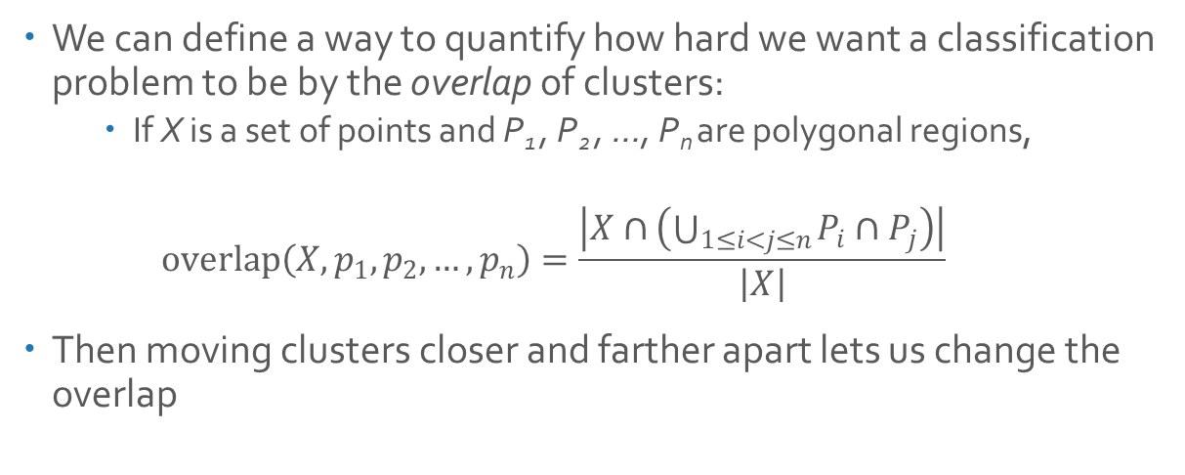
Controlling Overlap
We can define a way to quantify how hard we want a classification problem to be by the overlap of clusters:
If X is a set of points and P₁ , P₂ , …, P_{n} are polygonal regions,
$$overlap\left(X, p_{1},p_{2},…, p_{n}\right)=\frac{\left|X∩\left(\bigcup_{1≤i<j≤n}{P_{i}∩P_{j}}\right)\right|}{\left|X\right|}$$
Then moving clusters closer and farther apart lets us change the overlap

Slide 7
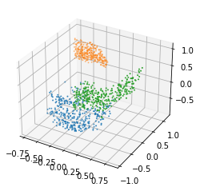
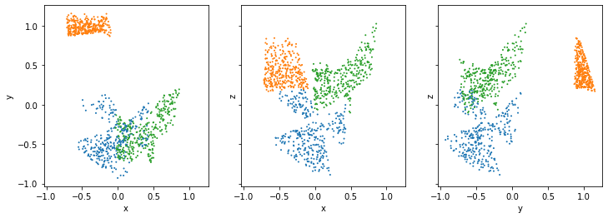
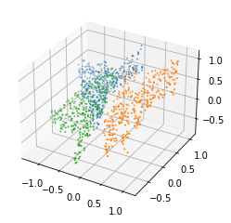
Polytopes in Higher Dimensions
We may want to generate datasets in higher dimensions
Clusters with polytope boundaries
Create features correlated with existing features

Slide 8
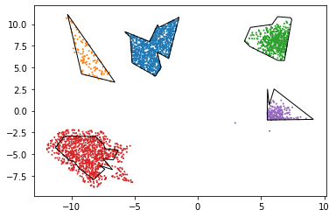
Other Capabilities
The tool we created can generate these clusters with a certain proportion of points outside each polygon, or with a normal distribution instead of uniform:

Slide 9
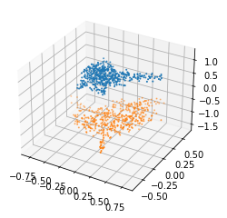
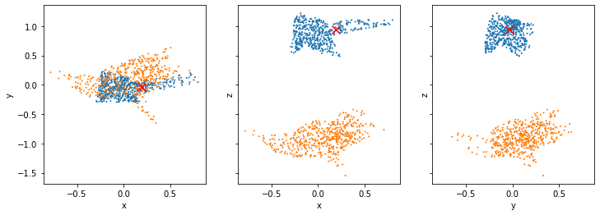
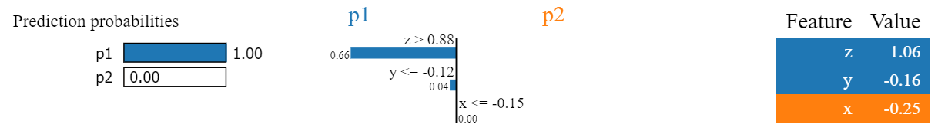

LIME: An Easy Example
We created an easy clustering problem with two polyhedral clusters that are separable by the $z=0$ plane:
We then trained a multi-layer perceptron (MLP) classifier on a subset of this data and asked LIME to explain the classifier’s prediction:

Slide 10
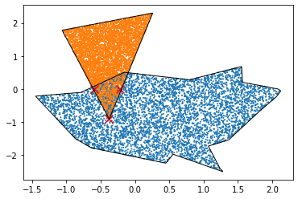
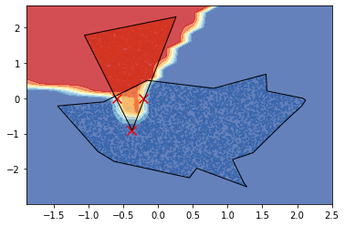
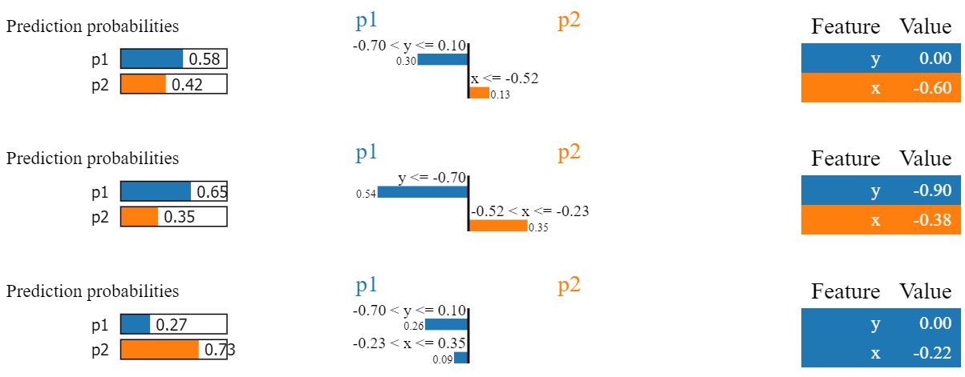
LIME: A Hard Example
We generated a 2-dimensional clustering problem with an overlap of 0.1061, trained an MLP classifier on it, and picked three challenging points:
We then asked LIME to explain the MLP’s predictions:

Slide 11
Results
Our tool can successfully produce customizable synthetic datasets which we can describe using geometry.
We have demonstrated that the datasets our tool produces are useful in investigating explainer behavior.

Slide 12
Future Work
Evaluate a wider variety of classification techniques
More robust methods of representing higher-dimensional polytopes
Extending overlap functionality to higher dimensions
Investigate other explanation frameworks

Slide 13
References
[1] M. Ribeiro, S. Singh, and C. Guestrin. 2016. "Why Should I Trust You?": Explaining the Predictions of Any Classifier. InProceedings of the 22nd ACM SIGKDD International Conference on Knowledge Discovery and Data Mining (KDD ’16). ACM, New York, NY, USA, 1135–1144.
[2] P. Biecek and T. Burzykowski. 2021. Explanatory Model Analysis. Chapman and Hall/CRC, New York.
[3] F. Akdag, C. Eick, and G. Chen. 2014. Creating Polygon Models for Spatial Clusters. InFoundations of Intelligent Systems, TroelsAndreasen, Henning Christiansen, Juan-Carlos Cubero, and Zbigniew W. Raś (Eds.). Springer International Publishing, Cham, 493–499.

